Slide 1
Loanalytic web
- Dreams come true

Slide 2
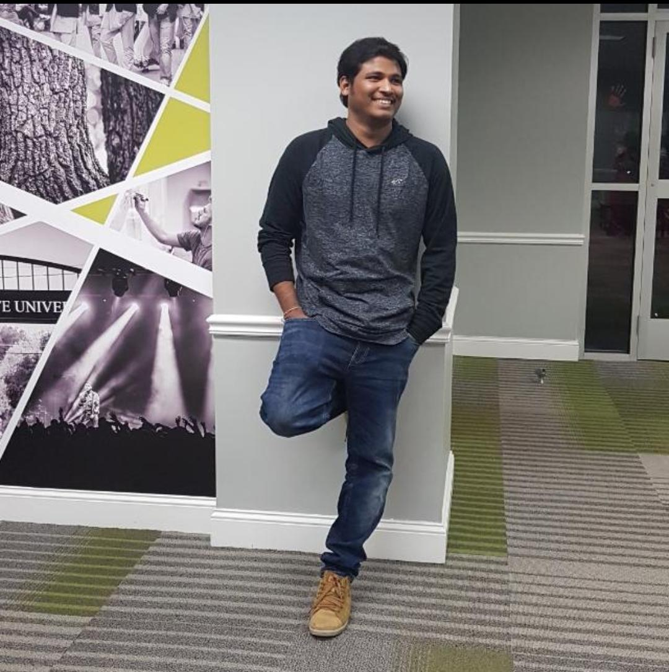
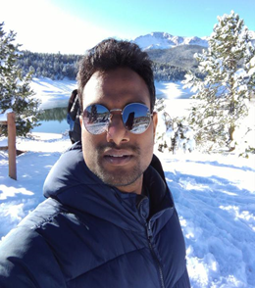
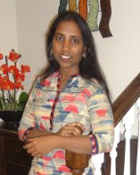
Vamsee Krishna Gangapatnam Gangadhar Adusumalli Gouthami Pasham

Slide 3
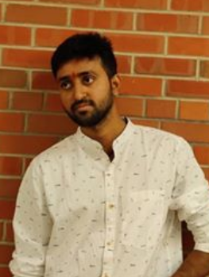
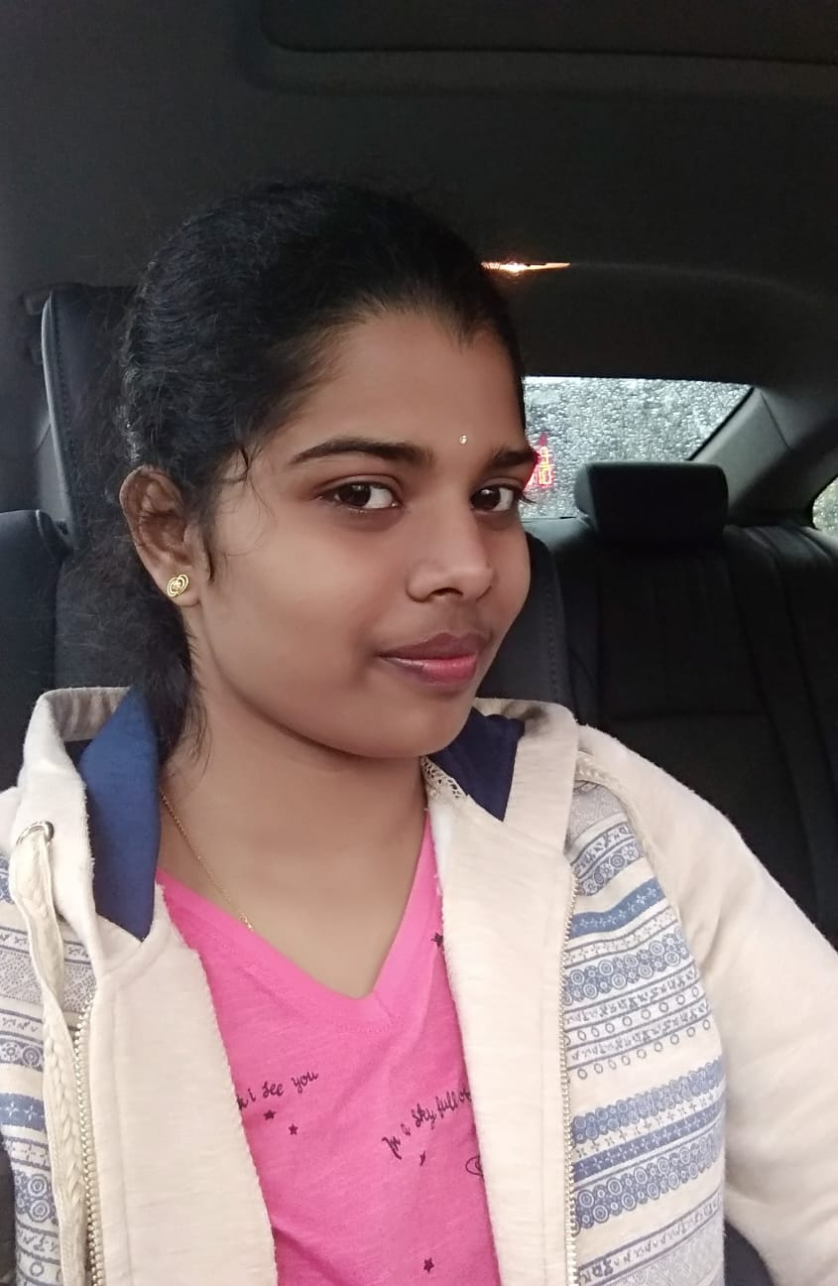
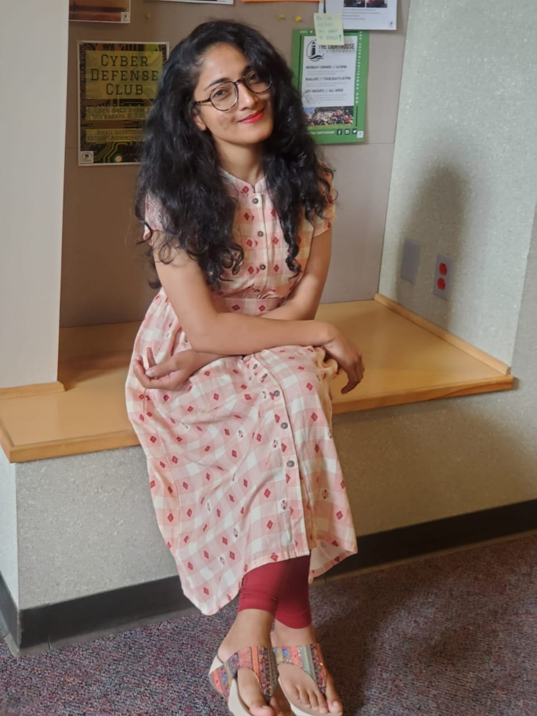
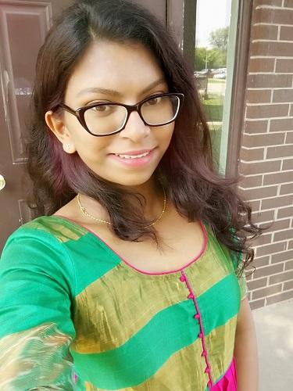
Taraka Raviteja Peddi Himabindu Poshala Meghana Putta Keerthi sree Kukunoor

Slide 4
Content
Introduction
User registration and login
Home page
Loan calculator
About us
View and edit profile
Contact us
Feedback
Apply loan
Admin functionalities
Chat

Slide 5
Introduction
Web application
Online loan processing website
Attractive user interface
Integrated features
Database optimization techniques
Vamsee Krishna Gangapatnam

Slide 6
User registration and login
Easy to register
Fill out the personal details
Sends verification link to email
Email verification
Validations
Vamsee Krishna Gangapatnam

Slide 7
Home page
Different loans provided by Loanalytic
Education loan
Personal loan
Mortgage loan
Gouthami Pasham

Slide 8
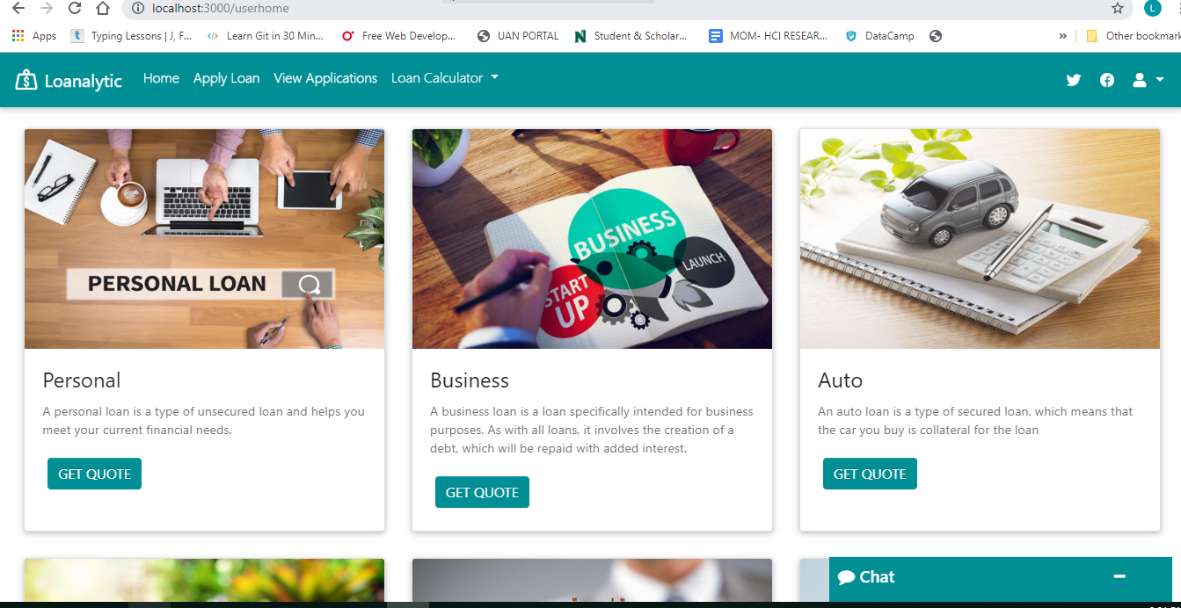
Gouthami Pasham

Slide 9
Loan calculator
Know your interest rate
Personal loan
Education loan
Gouthami Pasham

Slide 10
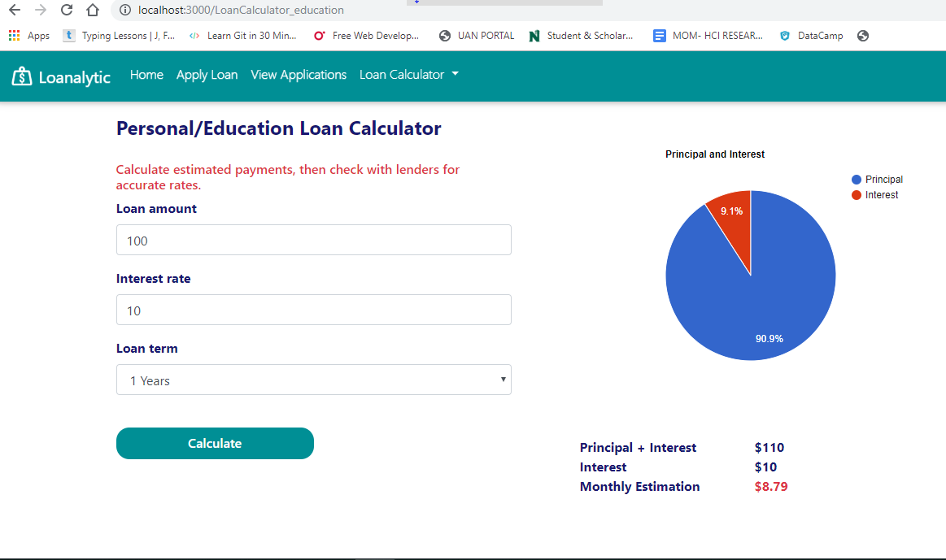
Gouthami Pasham

Slide 11
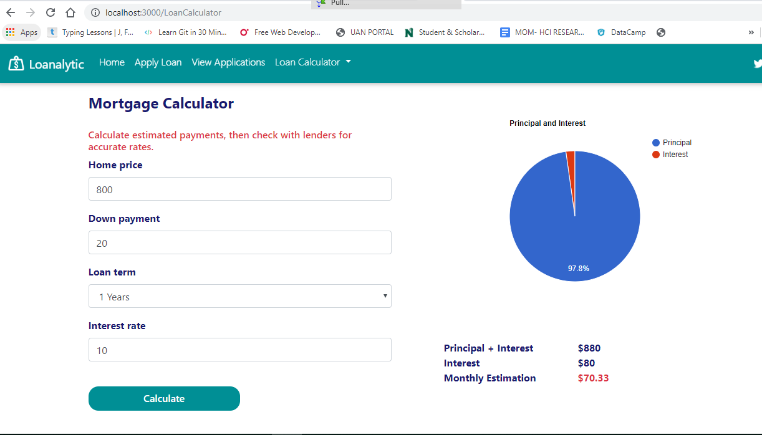
Gouthami Pasham

Slide 12
About us
Static page
About Loanalytic
Loan calculation
Loan description
Interest calculation
Gouthami Pasham

Slide 13
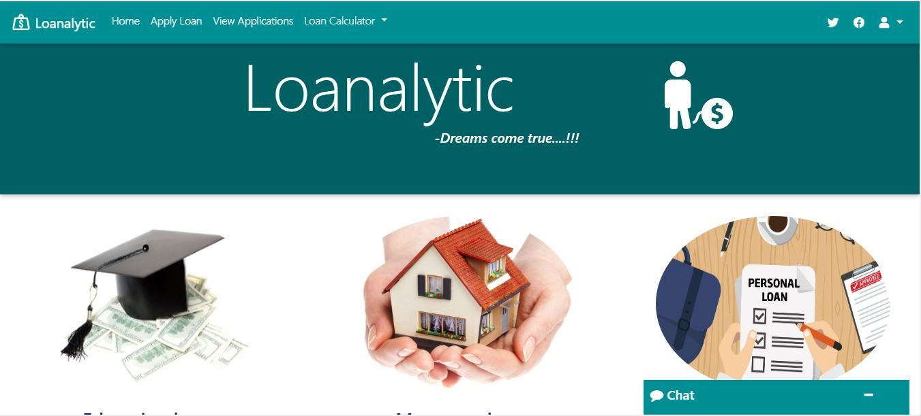
Gouthami Pasham

Slide 14
View and edit profile
Edit user profile
View profile
Password confirmation
Mandatory gmail
SSN number
Validations
Cancel and update buttons
Himabindu Poshala

Slide 15
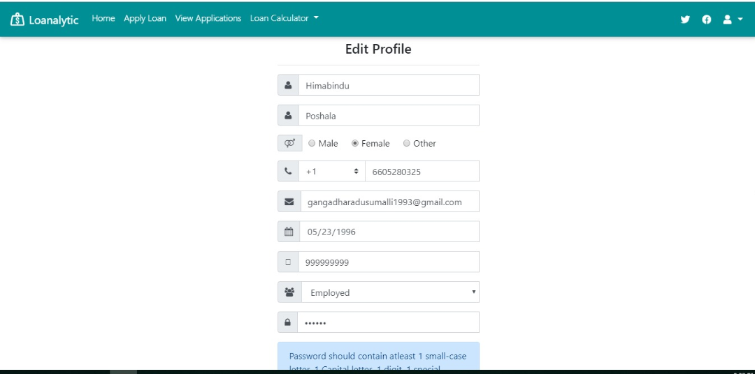

Slide 16
Contact us
Customer support
Email
Phone
Chat
Social media
Taraka Raviteja Peddi

Slide 17
Feedback page
Business success
Customer feedback
Individual rating
Individual review
Taraka Raviteja Peddi

Slide 18
Apply loan
Easy to apply
Apply multiple loans
Review uploaded documents
Track loan application status
Confirmation mail
Validations
Meghana Putta

Slide 19
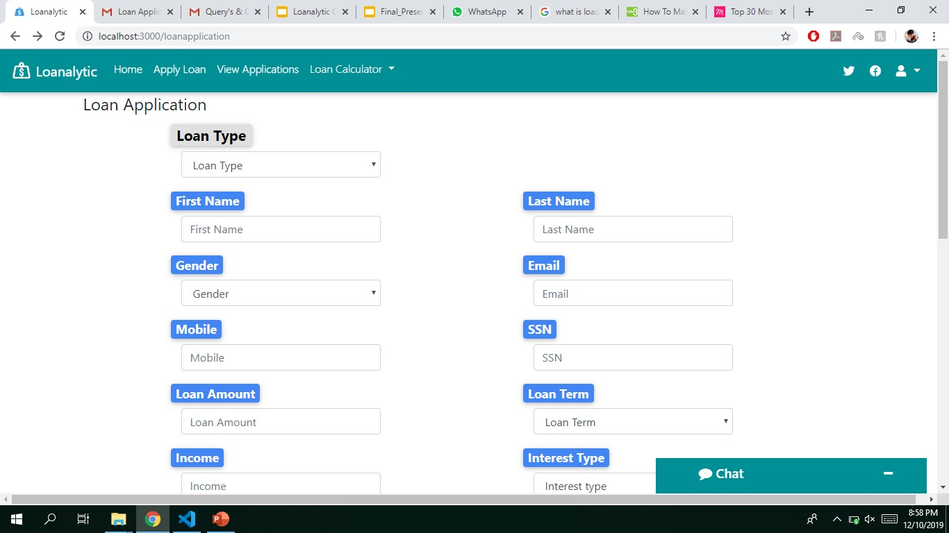

Slide 20
Admin functionalities
Login
View applications
Approved applications
Rejected applications
Keerthi sree Kukunoor

Slide 21
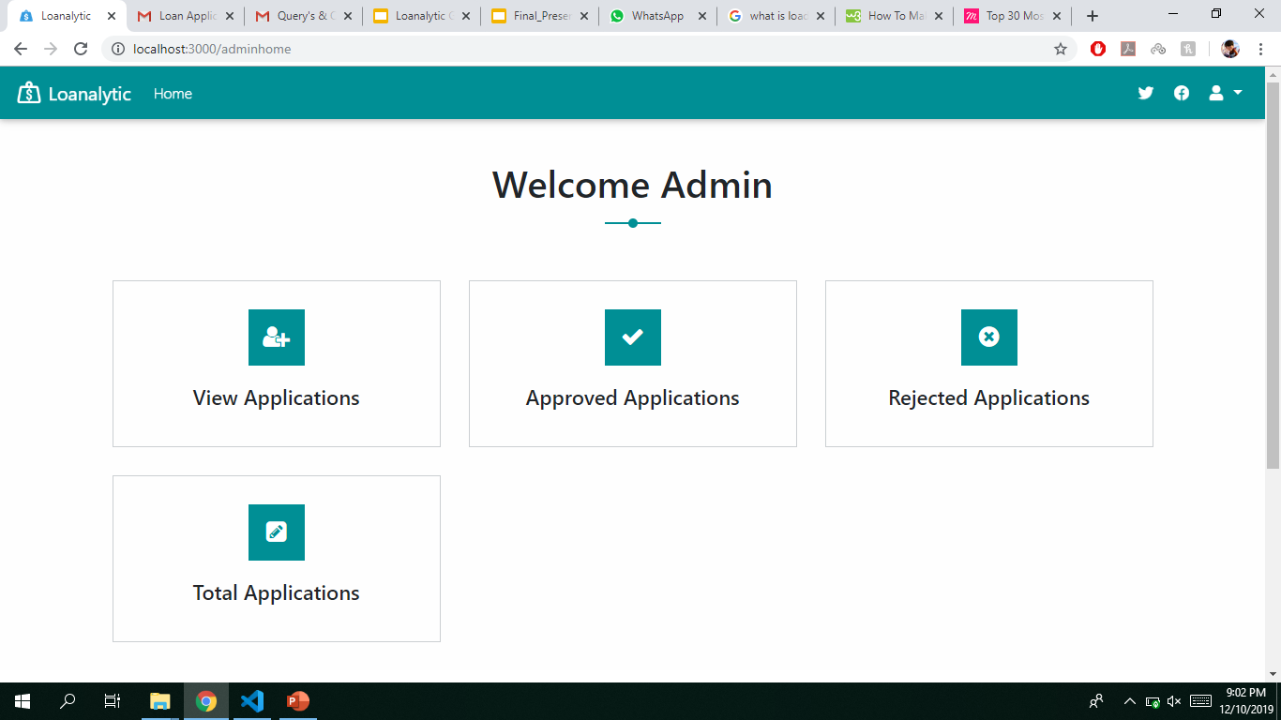

Slide 22
Admin view application
Admin can view all the applications
Access to loan information
Viewing documents
Approve or reject the application
Gangadhar Adusumalli

Slide 23
Chat
User can chat with the admin in case of issues
Accessible from any page
Both can exchange text information
Gangadhar Adusumalli

Slide 24
Thanks!
Any queries?

Slide 25
Vamsee Krishna Gangapatnam Gangadhar Adusumalli Gouthami Pasham

Slide 26
Peddi Tarakaraviteja Himabindu Poshala Meghana Putta Keerthi sree Kukunoor

